Slide 1
FILE SYSTEM
A file system is a method of organizing and retrieving files from a storage medium, such as a hard drive.
Without file system, all files would have no organization and it would be impossible for a file with the same name to exist.
Here, files are managed in a hierarchy, which allows you to view files in the current directory and then navigate into any subdirectories.

Slide 2
FILES AND DIRECTORIES
1. File :
A file is an object on a computer that stores data, information, settings, or commands used with a computer program.
2. Directories:
A directory is a location for storing files on your computer. Directories are found in a hierarchical file system, such as Linux, MS-DOS, OS/2, and Unix.
File systems usually consist of files separated into groups called directories.

Slide 3
FILE ATTRIBUTES AND OPERATIONS
Attribute | Bit Value
Read-Only (R) | 00000001
Hidden (H) | 00000010
System (S) | 00000100
Directory (D) | 00010000
Archive (A) | 00100000
Not Content Indexed (I) | 10000000000000
OPERATIONS
Create
Copy
Move
Rename
Delete

Slide 4
WINDOWS FILE SYSTEM
File Allocation Table (FAT) :
A file allocation table (FAT) is a table that an operating system maintains on a hard disk that provides a map of the clusters (the basic units of logical storage on a hard disk) that a file has been stored in.
New Technology File System(NTFS) :
The New Technology File System (NTFS) is the standard file structure for the Windows NT operating system. It is used for retrieving and storing files on the hard disk.
Resilient File System(ReFS):
The Resilient File System (ReFS) is Microsoft's newest file system, designed to maximize data availability, scale efficiently to large data sets across diverse workloads, and provide data integrity by means of resiliency to corruption.

Slide 5
File Allocation Table (FAT)
FAT Naming Convention:
FAT uses the traditional 8.3 file naming convention and all filenames must be created with the ASCII character set.
The name of a file or directory can be up to eight characters long, then a period (.) separator, and up to a three character extension.
The name must start with either a letter or number and can contain any characters except for the following: . “ / \ [ ] : ; | = ,

Slide 6
ADVANTAGE & DISADVANTAGE

Slide 7
NEW TECHNOLOGY FILE SYSTEM

Slide 8
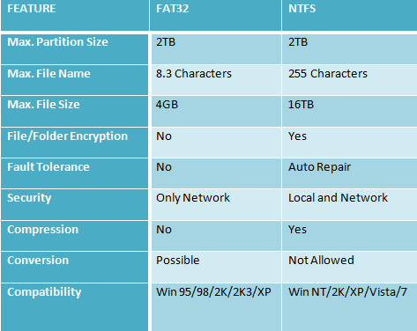
COMPARISON BETWEEN NTFS & FAT

